Slide 1

PHP
Introduction to Backend
@ Md. Mizanur Rahman

Slide 2

Frontend
Backend
Front end development is programming which focuses on the visual elements of a website or app that a user will interact with (the client side)
Backend Development is the term for the behind-the-scenes activities that happens when you do anything on a web application (the server side).
01

Slide 3
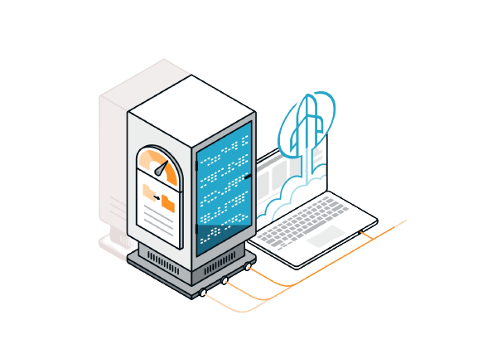
What is Backend ?
Backend is the server-side of the website.
It is the portion of software that does not come in direct contact with the users. It stores and arranges data, and also makes sure everything on the client-side of the website works fine.
The parts and characteristics developed by backend designers are indirectly accessed by users through a front-end application.
02

Slide 4
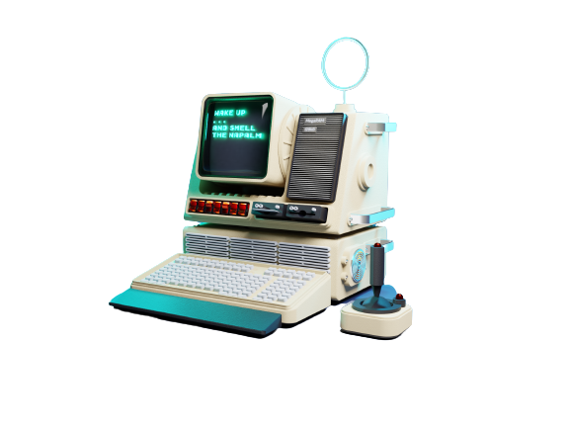
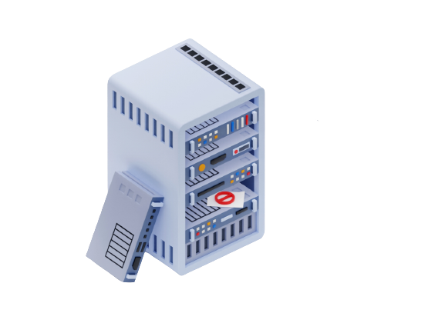
Client/Server
Client/server architecture is a computing model in which multiple components work in strictly defined roles to communicate
In this architecture, clients are request to server for some services.
And Server gives the service that a client want.
Many clients can communicate with a single server. Clients and server are connected and communicated with each other through communication protocols.
Request
Response
Client
Server
03

Slide 5







Backend Languages
PHP
Javascript
Python
Go
Ruby
Java
04

Slide 6
What is PHP?
The PHP is a programming language that allows web developers to create dynamic content that interacts with databases.
PHP – Hypertext Preprocessor
Open source general purpose scripting language
Server side language
Best suited for web development
Can be embedded into HTML
Interpreted language
05

Slide 7
Why PHP?
It is easy to learn
It is still very popular
Huge & active community to support
PHP CMS ( Wordpress, Magento, Drupal )
PHP Framework ( Laravel, Symfony, Yii2 )
High Demand of job market
06

Slide 8
Applications of PHP?
PHP performs system functions
PHP can handle forms i.e. gather data from files, save data to a file, through email you can send data, return data to the user.
You add, delete, modify elements within your database through PHP.
Access cookies variables and set cookies.
Using PHP, you can restrict users to access some pages of your website.
It can encrypt data.
07

Slide 9






What we need to code?
XAMPP / WAMP server
Code editor – Vscode, PhpStorm, Sublime Text, Atom etc
08

Slide 10
First PHP program
Just to give you a little excitement about PHP, I'm going to give you a small conventional PHP Hello World program,
<html>
<head>
<title>Hello World</title>
</head>
<body>
<? php echo "Hello, World!"; ?>
</body>
</html>
09

Slide 11
THIS IS IT
THANK YOU

